Slide 1


Slide 2

Big Picture
Objective: Learn what and how much different factors influence delivery time and understand options for forecasting
Complete work cards to deliver the most value!
Play in “day” rounds
Teams play independently but have interdependency with other teams

Slide 3
The Work
Cards depict the work needed
Circles represent effort to complete
Work must be started sequentially (no peeking!)
Some cards are urgent!
Some have a dependency on another team

Slide 4

The People
Each person can do 4 points of effort per day. Use cubes to keep track.
People can work in areas outside their specialty, but they get only half the points.
If you work on more than one team in a day, you lose one point per extra team (context-switching penalty).

Slide 5
Staff Your Teams!
Divide into teams of 4-7 people – they do not all have to be same size
Decide as a group each player’s role (wear a “role” name tag)
You can share people across more than one team.

Slide 6
Team Dependency
Some cards have a dependency on another team.
When you start a card that has one, draw a team card to see which team it is dependent upon.
To complete the card, someone from that team must spend time helping you. (Time spent helping another team counts against that person’s capacity.)

Slide 7
Blockers
Beginning of Next Day
For each blocked card, roll the die.
= still blocked (no work can be done on it that day)
= unblocked (remove the sticky, continue work)
End of Day
For each card in progress, roll the die.
=

Slide 8
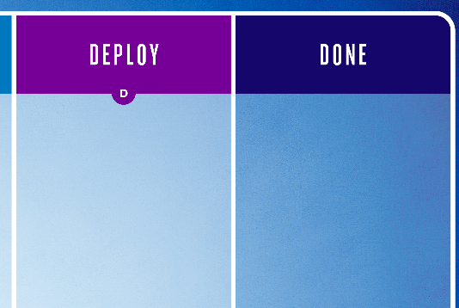
Deployment
For each card whose deployment work is complete, roll the die at the end of the day.
If you roll 1, the card requires rework. Move the card back to Deployment and redo the Deployment work.
=
Notes:
Anyone ever have to redo a deployment? Or does it always work on the first try?

Slide 9
Daily Actions
Decide how to use each person’s effort for the day
Pull in as many cards as you want and record the day for commit date
Roll to resolve any blocked cards
Tick off work on the cards and move them accordingly
Roll die for any completed card to determine if it deployed (1 = rework) and record the day delivered
For each card in progress, roll die to determine if it’s blocked (1 = blocked)
Update the day tracker and draw an event card.

Slide 10
Scoring
Card # | Commit Day | Delivery Day | Delivery Time | € | Prob. Forecast (50%/85%)
1
2
3
4
5
6
7
8
9
10
11
12
13
14
15
16
17
18
19
20
21
22
23
24
25
Estimate for Total Project: |  |  |  | Day
Estimate for MVP (#1-11): |  |  |  | Day
Re-Estimate for Total Project: |  |  |  | Day
Scoring is based on how long it takes you to deliver each card:
1-2 days: $700
3-5 days: $400
6+ days: $200
Urgent: -$100 per day
Before we start, we need an estimate!
Backlog = 25 cards
Average effort per card = 21

Slide 11


End of Day 10: Stop!
When you finish Day 10, ask the facilitator to visit your table.
=

Slide 12
Debrief
What sources of variation did you experience?
How did your approach to estimating change throughout the game?
Do you think that effort correlates with delivery time?

Slide 13
Why #NoEstimates?
Low process efficiency (typically 5-15% in software delivery) means that even if we nailed the effort estimates … we would be accurately predicting 5-15% of elapsed delivery time!
-- Troy Magennis
Is the initial sizing a good predictor for when you can get your stuff? In our case, the surprising truth was ”no.”
-- Mattias Skarin, Real-World Kanban
Often system factors account for more of the elapsed delivery time than different story sizes.
-- Troy Magennis
Notes:
It depends on your development and delivery process, but often system factors account for more of the elapsed delivery time than different story sizes. -- Magennis

Slide 14
#NoEstimates = No (Effort) Estimates
Estimating with minimal effort
Not basing our estimate on effort
-- Dimitar Bakardzhiev
We need to find ways to accurately forecast (or remove) the non-work time influenced by the entire system.
-- Troy Magennis

Slide 15
Reasons Why Estimating Is Difficult (V. Duarte)
Theory of Constraints
Little’s Law
Hofstadter's Law (Douglas Hofstadter): It always takes longer than you expect, even when you take into account Hofstadter’s Law.
Parkinson’s Law: Work expands so as to fill the time available for its completion.
Accidental Complication (J.B. Rainsberger): Every new feature has: Essential complication (How hard a problem is on its own) Accidental complication (“How much we suck at our jobs”)

Slide 16

Good game!
For more:
mattphilip.wordpress.com/tag/noestimates
github.com/pip72/no-estimates-game
noestimatesbook.com (Vasco Duarte)
focusedobjective.com (Troy Magennis)
actionableagile.com (Dan Vacanti)
infoq.com/articles/noestimates-monte-carlo (Dimitar Bakardzhiev)
Special thanks to designer Angie Haakenson!

